Slide 1
SQL Server 2019 Big Data Clusters Webinar
We start sharply at 09:30am
All material now available at https://github.com/MikeSpark/BigDataCluster2020March

Slide 2

SQL Server 2019 Big Data Clusters

Slide 3
The task of getting insights from ever-increasing data is tough
Barriers to insights are barriers to success

Slide 4
SQL Server 2019
Intelligence over all your data
Integrating all data
Managing all data
Analyzing all data
Unified access to all your data with unparalleled performance
Easily and securely manage
data big and small
Build intelligent apps and AI with all your data

Slide 5

What is Big Data? And Why?
“Big Data is any data you can’t process in the time you want with the systems you have.” – Buck Woody
The volume, velocity and variety of the data is far too great
Distributed, unstructured, semi-structured, compute, TB, PB, …
Analytics – Ingest, process, analyze, repeat
Machine Learning and IoT

Slide 6

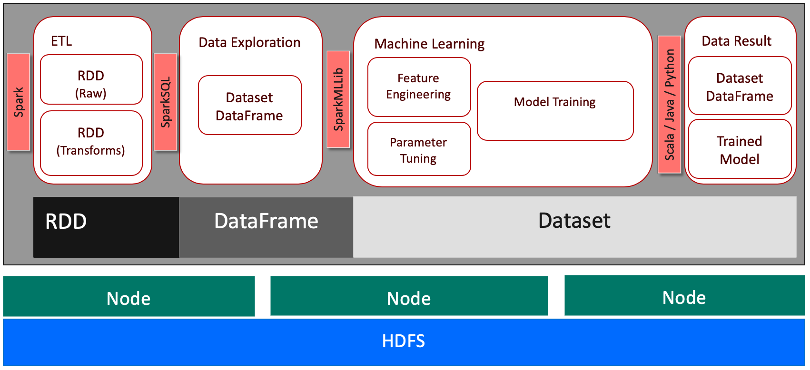
Big Data and the Zoo
Hadoop
Spark
Notes:
The original Hadoop project was to index the WWW at the time in 2005

Slide 7
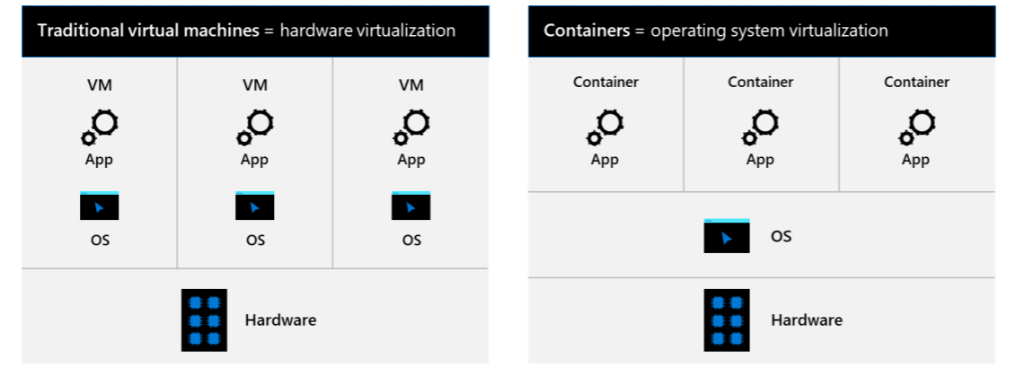
From Virtual Machines to Containers
Portable
Run anywhere containers are supported
Lightweight
Reduced disk, CPU, and memory footprint
Consistent
Consistent image of SQL Server, scripts, and tools
Efficient
Faster deployment, reduced patching, and less downtime

Slide 8

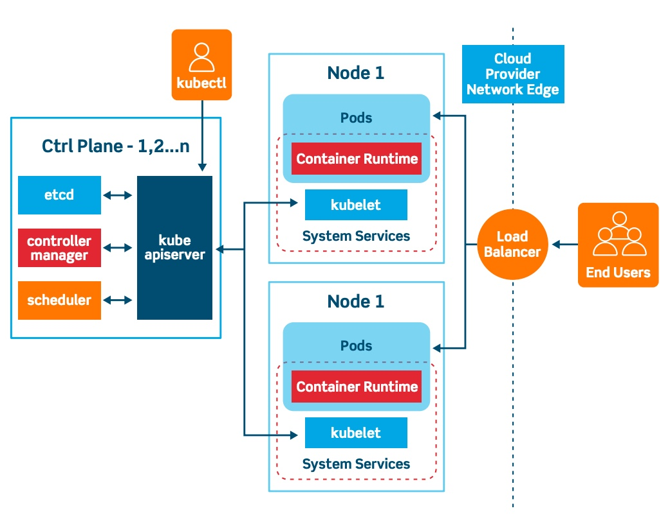
Along comes the Helmsman

Slide 9




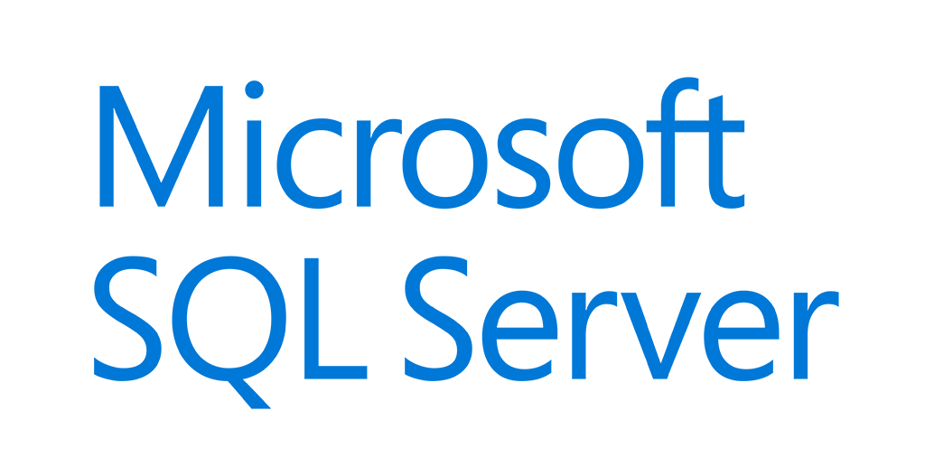
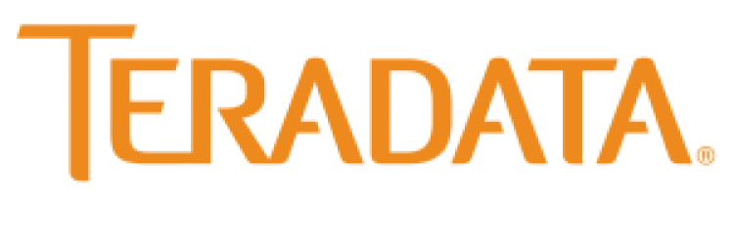









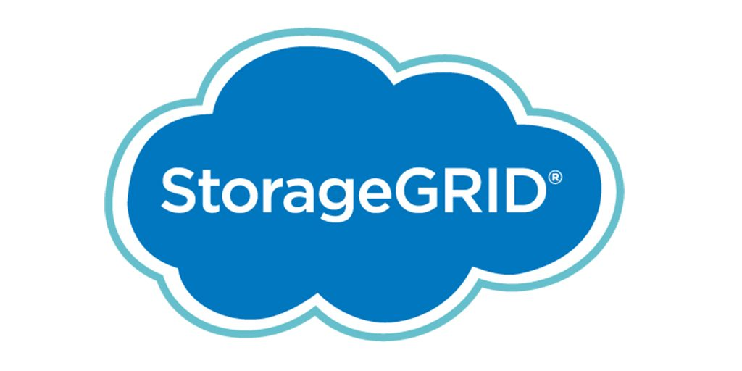


SQL Server 2019 Big Data Clusters
The combination of SQL Server, Polybase, HDFS, Spark, and Machine Learning in one solution
Custom apps
BI
Analytics
Controller
SQL Server master instance
Availability Group
Active Directory
Kubernetes
PolyBase
Scale performance with compute pool
Languages
App Deploy
Any external data source
SQL Compute Node
SQL Compute Node
…
SQL Compute Node
PolyBase
Data lakes with storage pool
SQL Server
SQL Server
…
SQL Server
Scale out data mart with Data pool
HDFS
HDFS
HDFS
HDFS
HDFS
HDFS
HDFS tiering
Balzano brings together diverse data on one shared platform to build and deploy and AI solution for clinical radiology
Intelligence over any data
Notes:
Whole quote:
"Building and deploying our vertical AI-solution for clinical radiology combines very diverse implementation paradigms, data formats and regulatory requirements. SQL Server 2019 big data clusters allowed us to accommodate and integrate all aspects from one shared platform - for our data scientists with their deep learning as well as for our software engineers who wire up workflows, security and scalability. At runtime, our healthcare customers benefit from simple containerized deployment and maintenance while being able to move our solution between on-prem and the cloud easily."
René Balzano, Founder and CEO, Balzano

Slide 10
Deploying a Big Data Cluster
Kubernetes choices
Azure Kubernetes Service (AKS)
Your Kubernetes Cluster (kubeadm)
Deployment Tools
azdata CLI to deploy
Customize with json
Azure Data Studio Wizard and Notebook deployment
Single deployment solutions
Python script for AKS
Bash script for kubeadm
Deployment Guidance
Minimum 8 CPUs, 64Gb RAM, 100Gb Disk, 24 disks
Offline supported

Slide 11




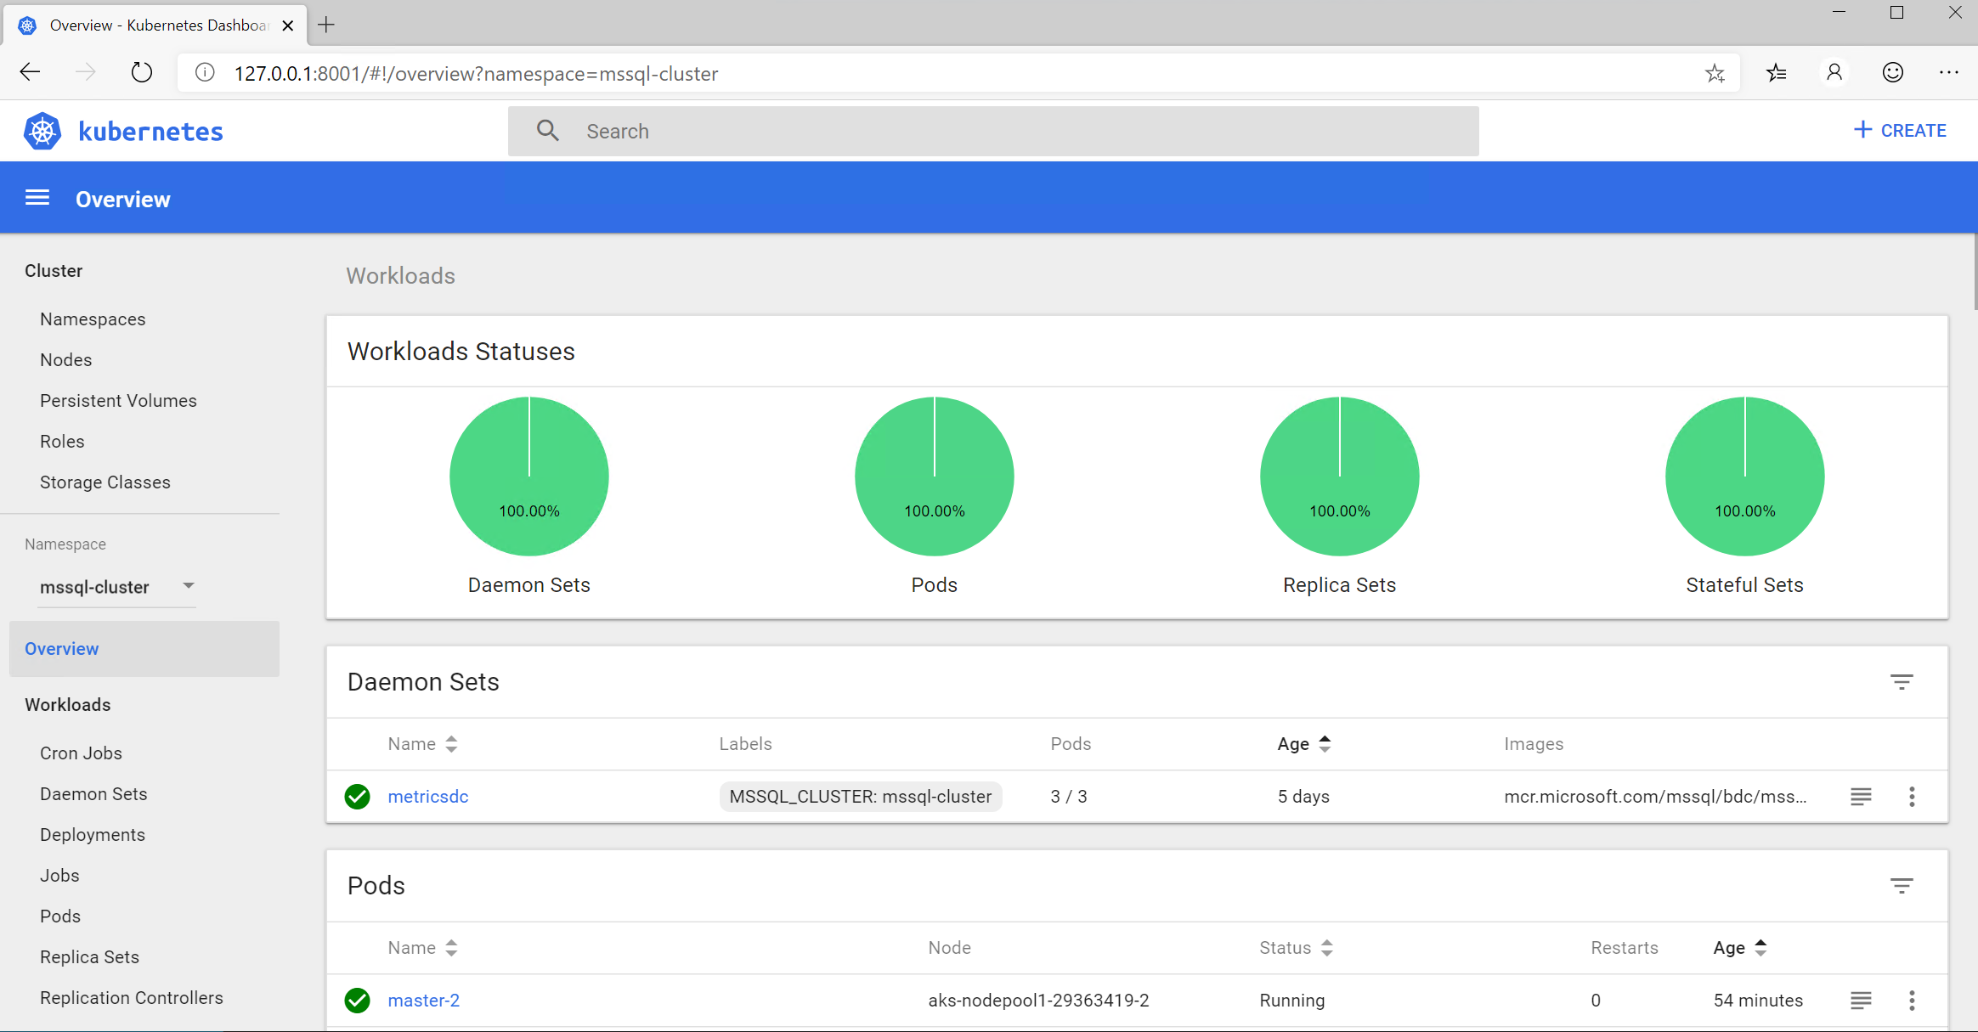
Managing and Monitoring Big Data Clusters
Management Endpoints
controller – Cluster Management Service
metricsui -Metrics with Grafana
logsui - Logging with Kibana
spark-history - Spark Job History
yarn-ui – Spark Job Diagnostics
azdata is the “kubectl” of Big Data Clusters
Dashboards with Azure Data Studio
Troubleshooting Guides with Notebooks
Use kubectl
Copy files into containers like Database Backups
Dive into logs like SQL ERRORLOG files
Dive into Kubernetes events and pod details
Kubernetes Dashboard

Slide 12




Using a Big Data Cluster through Endpoints
tds
sql-server-master
SQL Server Master Instance
gateway
Gateway to access HDFS files, Spark
webhdfs
HDFS File System Proxy
livy
Proxy for running Spark statements, jobs, applications
app-proxy
Application Proxy
sql-server-master-readonly
"/api/v1/bdc/endpoints
controller-svc
Port 443
controller – Cluster Management Service

Slide 13
MSSQL on k8s
https://docs.microsoft.com/en-us/sql/linux/tutorial-sql-server-containers-kubernetes?view=sql-server-ver15
https://github.com/microsoft/sql-server-samples/tree/master/samples/features/high%20availability/Kubernetes
https://cloudblogs.microsoft.com/sqlserver/2018/12/10/availability-groups-on-kubernetes-in-sql-server-2019-preview/

Slide 14
Integrating all data
Notes:
Challenge: Data movement can be problematic
Pillar: Gain unified access to all your data using data virtualization

Slide 15
Two methods for data integration
Data movement
Data virtualization
Data retrieved from source at query time
Move/ copy
Data
Data
Data
Data
Data is virtually represented
Data is actually stored in source
Data movement or “ETL/ELT” moves or creates a copy of the data from one source to another to make it available for a query
Data virtualization integrates data at query time, without replicating or moving the data

Slide 16
Data movement is a barrier to insights
Duplicated storage costs
Engineering effort to build and maintain data pipelines
Costs
Speed
Delays in integrate data before it can be used
Increased data latency
Security
Increased attack surface area
Inconsistent security models
Quality
Data quality issues can be created by ETL pipelines
3/4 of respondents say that
untimely data has inhibited business opportunities
Compliance
Increased governance issues
*IDC 3rd Platform Information Management Requirements Survey, Oct 2016
Notes:
Source: 3rd Platform Information Management Requirements Survey, IDC, October, 2016, n=110
An IDC InfoBrief | May 2017 | “Choosing a DBMS to Address the Challenges of the Third Platform”

Slide 17
Data virtualization creates solutions
Costs
Lower storage costs
Less dev time spent on integration
Speed
Rapid iterations and prototypes
Timely data
Security
Smaller attack surface area
Consistent security model
Quality
Fresh and accurate data
Compliance
Easier data governance
Notes:
Data virtualization benefits include cost, speed, security, quality, and compliance.

Slide 18
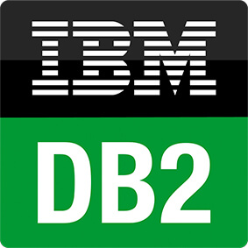






SQL Server 2019 is the hub for integrating data
Analytics
T-SQL
Apps
SQL Server
PolyBase external tables
Scale out compute for performance
ODBC (Windows Only)
NoSQL
Relational databases
Big data
Excel
SQL Server
SQL Database
SQL Data Warehouse
Azure Cosmos DB
Azure Blob Storage
(SQL Server 2016+)
Notes:
Query across relational and non-relational data stores including Oracle, Teradata, Mongo etc
Besides supporting Hadoop, now PolyBase will let you query over RDBMS, NoSQL and generic ODBC sources.

Slide 19
Unified relational and big data using data virtualization
Apache Hadoop Distributed File System (HDFS) storage and Spark are built-in to SQL Server big data clusters
HDFS provides a scale-out storage tier for storage capacity of 1,000x a traditional SQL Server
Spark provides a scale-out compute tier for data preparation, large data queries, and machine learning tasks
T-SQL
SQL Server master instance
PolyBase external tables
Spark
SQL Server
Spark
SQL Server
Spark
SQL Server
HDFS Data Node
HDFS Data Node
HDFS Data Node
Storage Pool
Notes:
Picture: Master node of Kubernetes. It looks like a server (use Kubernetes slide from v3 of customer deck)
Below are many nodes of the Kubernetes, being driven by the master.
Show persistent storage that the container mounts to as a rectangle under the K8s node – “Persistent storage”

Slide 20
HDFS Tiering: unified data lakes, caching for faster queries
Directories from Azure Data Lake or CDH/HDP HDFS can be mounted as virtual directories in the big data cluster HDFS
SQL Server and Spark can virtually access files in remote file systems just as they do files in the big data cluster HDFS
Data is seamlessly cached from the remote file system for faster query performance by bringing the data to the compute
T-SQL
SQL Server master instance
PolyBase external tables
Spark
SQL Server
Spark
SQL Server
Spark
SQL Server
HDFS Data Node
HDFS Data Node
HDFS Data Node
Mount directory
Storage Pool
Mount directory
Azure Data Lake
HDFS
Notes:
Picture: Master node of Kubernetes. It looks like a server (use Kubernetes slide from v3 of customer deck)
Below are many nodes of the Kubernetes, being driven by the master.
Show persistent storage that the container mounts to as a rectangle under the K8s node – “Persistent storage”

Slide 21
Demo
Data Virtualization over built-in HDFS

Slide 22
High performance with data pools
T-SQL
Cache and combine datasets from external sources without writing code
Offload query execution from source databases
Bring data to the big data cluster for faster query times
Data is automatically distributed across the data pool instances
Columnstore indexes are automatically applied to compress data storage and boost query performance by up to 10x
Filtering and local aggregations happen in parallel across the data pool instances
Scale the data pools as needed for better performance
SQL Server master instance
PolyBase external tables
Scale-out data pool
Shard 1
Shard 2
Shard n
PolyBase
connectors
Cosmos DB
Oracle
Spark
SQL Server
Spark
SQL Server
Spark
SQL Server
HDFS Data Node
HDFS Data Node
HDFS Data Node
Notes:
Increase performance for data virtualization using data pools in scale-out data pools
SCENARIO: Scale out SQL Server with Hadoop and Spark to unlock Big Data
Scenario: A car manufacturing company wants to join data from across multiple sources including Cloudera for sensor data, SQL Server that has customer data with PII (that they want to keep in SQL and mask), and Cosmos DB that has connected car data in Azure. Today the car manufacturer has a Cloudera cluster with 100 nodes on-prem and 1.5 Petabytes of data. They are running into issues with Hive performance for interactive queries.
Problem: To join this data now, they would have to move it into a single system, a huge undertaking.
Solution: Create a shared, scalable data lake based on HDFS. Expose these datasets as a shared semantic layer, so that it can be used to business analysts without moving the data.
In this scenario, you still have to refresh the data periodically (still lives in its home database – not in the data lake)

Slide 23
Boost performance with compute pools
T-SQL
SQL Server
PolyBase external tables
Compute pool instances query partitions from external data sources in parallel
Compute pool instances work together to perform cross-partition aggregations and sorts
Compute pool offloads query execution from the master instance and provide scale-out compute capacity
Compute pool works over data pool, storage pool, or external data sources
Compute pool is stateless and can be scaled up/down as needed
Scale-out compute pool
Compute instance
Compute instance
Compute instance
Compute instance
Scale-out data pool
Shard 1
Shard 2
Shard n
Direct,
no cache
Direct,
no cache
Cosmos DB
Oracle
Spark
SQL Server
Spark
SQL Server
Spark
SQL Server
HDFS Data Node
HDFS Data Node
HDFS Data Node
Notes:
Increase performance for data virtualization using data pools in scale-out data pools
SCENARIO: Scale out SQL Server with Hadoop and Spark to unlock Big Data
Scenario: A car manufacturing company wants to join data from across multiple sources including Cloudera for sensor data, SQL Server that has customer data with PII (that they want to keep in SQL and mask), and Cosmos DB that has connected car data in Azure. Today the car manufacturer has a Cloudera cluster with 100 nodes on-prem and 1.5 Petabytes of data. They are running into issues with Hive performance for interactive queries.
Problem: To join this data now, they would have to move it into a single system, a huge undertaking.
Solution: Create a shared, scalable data lake based on HDFS. Expose these datasets as a shared semantic layer, so that it can be used to business analysts without moving the data.
In this scenario, you still have to refresh the data periodically (still lives in its home database – not in the data lake)

Slide 24
Managing all data
Notes:
Challenge: Managing relational and Big Data is complicated
Pillar: Simplify big data management with improved performance and security

Slide 25
Manage all your relational and big data in one unified system
Deploy big data and relational as a single, unified solution
Upgrade big data and relational at the same time and be assured of component compatibility
Provided, updated, and supported by Microsoft as part of SQL Server
Notes:
Kubernetes-based Big Data distribution is easy to deploy, upgrade and patch, and scales in seconds using compute pools
visually tie this container to the containers in the previous slide
zoom in to show you what's inside one of the containers

Slide 26
Simplified deployment with containers & Kubernetes
A container is a standardized unit of software that includes everything needed to run it
Kubernetes is an open source container hosting platform
Benefits of containers and Kubernetes:
Fast to deploy, easily scriptable
Upgrades are easy - just pull a new image
Self-contained – no installation/uninstallation required
Scalable, multi-tenant, and designed for elasticity
Consistently run anywhere: on-prem, Azure, other clouds
Spark
SQL Server
Containers
HDFS Data Node
Kubernetes pod
Notes:
Picture: Master node of Kubernetes. It looks like a server (use Kubernetes slide from v3 of customer deck)
Below are many nodes of the Kubernetes, being driven by the master.
Show persistent storage that the container mounts to as a rectangle under the K8s node – “Persistent storage”

Slide 27




Big data clusters deployed on Kubernetes, OpenShift, AKS
Control
Controller Svc
Proxy
Kibana
Grafana
Custom apps
Configuration Store (SQL Server)
Elastic Search
InfluxDB
BI
Analytics
Cluster
SQL
SQL Server master instance
External data sources
Compute pool
Directly read from HDFS
SQL Compute Instance
SQL Compute Instance
SQL Compute Instance
SQL Compute Instance
SQL Compute Instance
…
SQL Compute Instance
Application pool
Data pool
Storage pool
Application
SQL Datapool Instance
SQL Datapool Instance
Spark
SQL Server
Spark
SQL Server
Spark
SQL Server
…
HDFS Datanode
HDFS Datanode
HDFS Datanode
IoT data
Storage
Storage
Kubernetes pod
Node
Node
Node
Node
Node
Node
Node
Persistent storage
Notes:
Increase analytics and apps performance with scale out data pools

Slide 28
Licensing

Slide 29
Licensing SQL Server 2019 Big Data Cluster
SQL Server 2019 Big Data Clusters makes it easier to manage a big data environment. It provides key elements
of a data lake—Hadoop Distributed File System (HDFS), Spark, and analytics tools—deeply integrated with SQL
Server and fully supported by Microsoft. To license SQL Server 2019 Big Data Cluster, both components must
be licensed
• SQL Server Master Instance - The Server or OSE running the SQL Server Master Instance must be assigned an appropriate number of SQL Server 2019 Enterprise or Standard Edition core licenses. The cores must
also be covered with SA or subscription equivalent to be able to deploy Big Data Cluster. The number of
core licenses needed, depends on whether customers are licensing the physical server or individual virtual
operating system environments (OSEs).
• SQL Server Big Data Nodes – Server or OSE used for SQL Server Big Data Nodes must be licensed using
SQL Server Big Data Node cores. Big Data node cores can be purchased as subscriptions in packs of 2 cores
and are priced differently than SQL Server Enterprise or Standard licenses. SQL Server Master Instance
must be covered with SA or subscription equivalent to be able to deploy big data nodes.

Slide 30
SA Benefit - Big Data Node core entitlement overview
SQL Server SA benefit for Big Data node core entitlement will provide a limited number of Big Data node cores
at no additional costs. The number of Big Data node cores available for use as part of this SA benefit is
dependent upon the SQL Server Master Instance edition and license count.
• SQL Server 2019 Big Data Clusters with Enterprise Edition as Master instance get 8 times as many Big Data
node cores licenses as the number of licenses for master instance
• Big Data Clusters with SQL Server 2019 Standard Edition as Master instance get the same number of Big
Data node cores licenses as the number of licenses for master instance

Slide 31
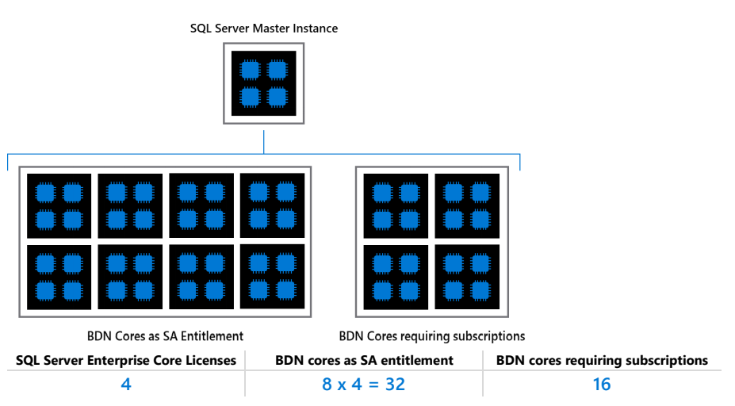
Sample Scenario

Slide 32
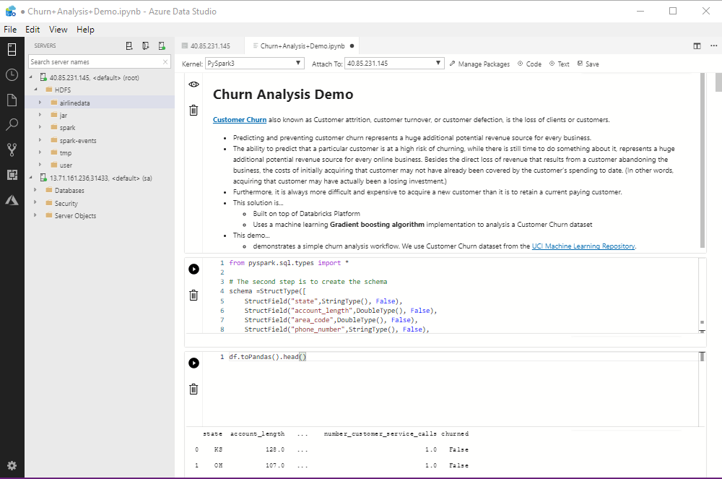
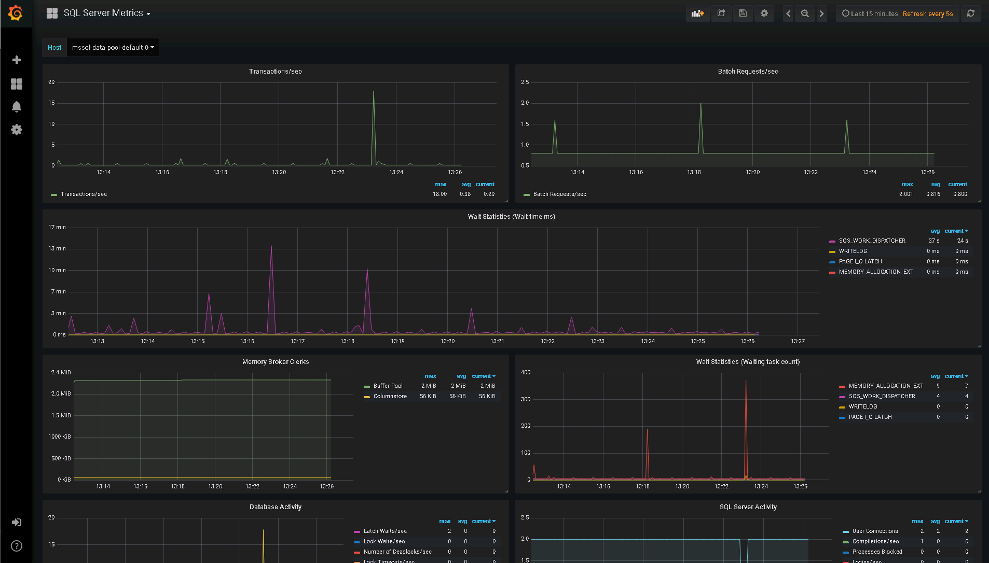
Unified experience
Azure Data Studio is a unified tool for DBAs, data engineers, and data scientists
Notebook experience for both T-SQL and Spark
HDFS file management
Built-in administration provides easy to use cloud-style managed services for HA, monitoring, backup/recovery, security, and provisioning.
REST API and command line tools simplify automation for SQL and big data
The development and management experience is consistent on-prem or any cloud
Advanced Spark and YARN user experience
Notes:
Unified development and administration experience for big data and SQL Server users

Slide 33
Unified security and governance
External data sources
Integrated Big Data and SQL Server security model
Simple, single sign-on with Active Directory authentication
Unified connection experience in Azure Data Studio to connect to SQL Server, HDFS, Spark, and admin UIs at the same time
Manage data access with SQL Server security roles
Access auditing for compliance
Impersonation
Impersonation
SQL Server
master instance
Active Directory
Active Directory
Apps, Reports, Users
Azure Data Studio
HDFS/Spark

Slide 34
Analyzing all data
Notes:
Challenge: Managing relational and Big Data is complicated
Pillar: Simplify big data management with improved performance and security

Slide 35



Big data clusters: a complete AI platform
Ingest
Store
Prep & train
Model & serve
Logs, files and media
(unstructured)
Data pools
Spark
Predictive apps
Master instance
Sensors and IoT
(unstructured)
SQL Server Integration Services (SSIS)
HDFS
Spark ML
Business/custom apps
(Structured)
Master instance
SQL Server ML Services
REST API containers for models
BI tools
Simplified management and analysis through a unified deployment, governance, and tooling
Notes:
Easy tooling to ingest, store, prep & train, model and serve high velocity using unified data management
Spark streaming in the box
Data preparation tools
Integrated Jupyter notebooks

Slide 36
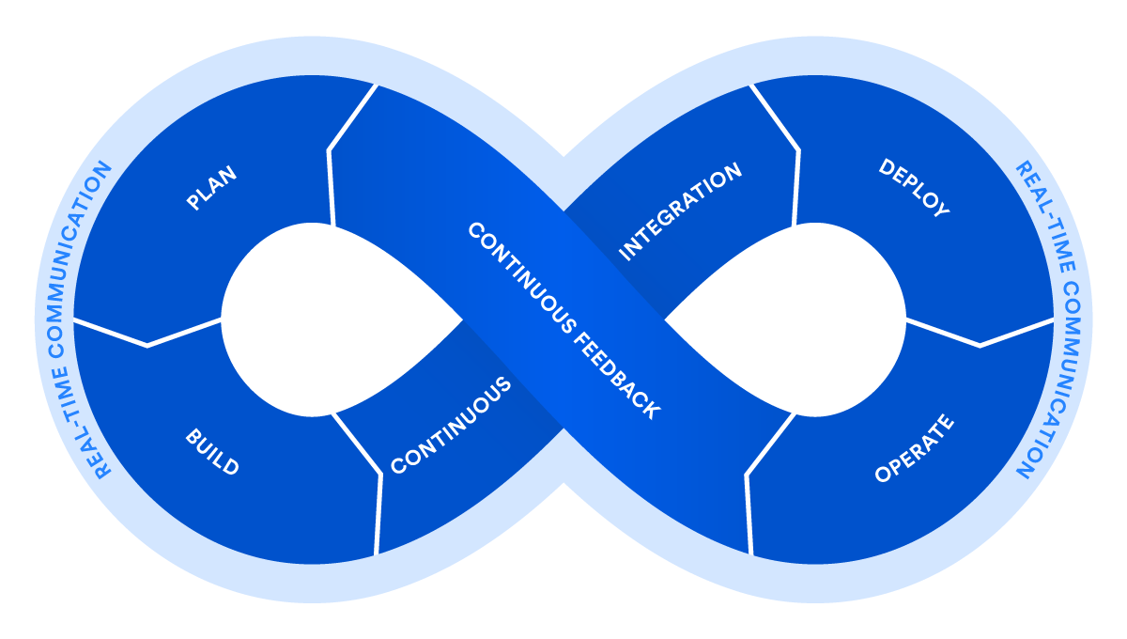
Big data clusters: a complete AI platform
GATHER DATA
MODEL
DEPLOY
CONTINOUS FEEDBACK
TRAIN
SCORE
ENGINEER FEATURES
Notes:
Easy tooling to ingest, store, prep & train, model and serve high velocity using unified data management
Spark streaming in the box
Data preparation tools
Integrated Jupyter notebooks

Slide 37


“With SQL Server 2019 big data clusters, we can solve for on-demand big data experiments. We can analyze cancer research data coming from dozens of different data sources, mine interesting graph features and carry out analysis at scale. With the big data cluster feature in SQL Server, we have been able to eliminate non-trivial challenges and are able to move our data onto cloud servers to use high quality compute resources for the length of a study and not be restricted by performance constraints.”
Pieter Derdeyn, Knowledge Engineer Systems Imagination

Slide 38
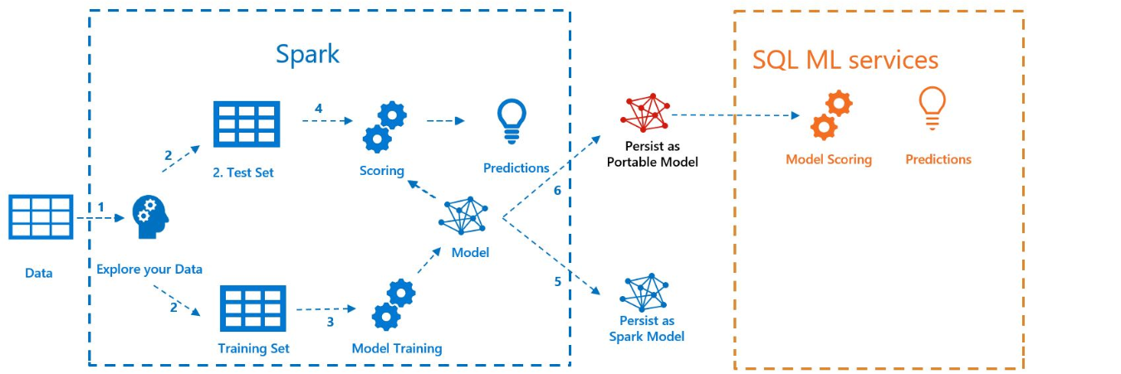
BDC with MLeap

Slide 39
Demo
Machine Learning with Spark notebooks

Slide 40
Intelligence over all data drives innovation
SQL Server 2019 big data clusters
Data virtualization
Managed SQL Server, Spark, and data lake
Complete AI platform
Admin portal and management services
Integrated AD-based security
Analytics
T-SQL
Apps
REST API containers for models
SQL Server External Tables
SQL Server
Spark
SQL Server
ML Services
Spark & Spark ML
Compute pools and data pools
Scalable, shared storage (HDFS)
Open database connectivity
NoSQL
Relational databases
HDFS
External data sources
HDFS
Combine data from many sources without moving or replicating it
Scale out compute and caching to boost performance
Store high volume data in a data lake and access it easily using either SQL or Spark
Management services, admin portal, and integrated security make it all easy to manage
Easily feed integrated data from many sources to your model training
Ingest and prep data and then train, store, and operationalize your models all in one system
Integrating all data
Managing all data
Analyzing all data

Slide 41
Intelligence over all data drives innovation
SQL Server 2019 big data clusters
Data virtualization
Managed SQL Server, Spark, and data lake
Complete AI platform
Admin portal and management services
Integrated AD-based security
Analytics
T-SQL
Apps
REST API containers for models
SQL Server External Tables
SQL Server
Spark
SQL Server
ML Services
Spark & Spark ML
Compute pools and data pools
Scalable, shared storage (HDFS)
Open database connectivity
NoSQL
Relational databases
HDFS
External data sources
HDFS
Combine data from many sources without moving or replicating it
Scale out compute and caching to boost performance
Store high volume data in a data lake and access it easily using either SQL or Spark
Management services, admin portal, and integrated security make it all easy to manage
Easily feed integrated data from many sources to your model training
Ingest and prep data and then train, store, and operationalize your models all in one system
Integrating all data
Managing all data
Analyzing all data

Slide 42
Get started with SQL Server 2019
Download and try it: https://aka.ms/ss19
Get started with BDC at https://aka.ms/sqlbdc
Use our free training: https://aka.ms/sqlworkshops
Use examples through our https://aka.ms/SQL2019Notebooks
Learn from videos: https://aka.ms/sql2019learning
Read what’s new for SQL 2019: documentation
Watch how to Modernize SQL Server: check out the video
Read the licensing guide
Get the book: https://aka.ms/sql2019book

Slide 43
Q&A

Slide 44

Thank you for joining us.
© 2018 Microsoft Corporation. All rights reserved. Microsoft, Windows, Windows Vista and other product names are or may be registered trademarks and/or trademarks in the U.S. and/or other countries.
The information herein is for informational purposes only and represents the current view of Microsoft Corporation as of the date of this presentation. Because Microsoft must respond to changing market conditions, it should not be interpreted to be a commitment on the part of Microsoft, and Microsoft cannot guarantee the accuracy of any information provided after the date of this presentation. MICROSOFT MAKES NO WARRANTIES, EXPRESS, IMPLIED OR STATUTORY, AS TO THE INFORMATION IN THIS PRESENTATION.

